Slide 1



Teaching of " Embedded System Design and Application "
Hadoop Big Data Technology
International Education School
Ren Meng
Notes:
https://www.renrendoc.com/paper/111762807.html
https://www.renrendoc.com/paper/111762807.html
Topic: Huffman codec system
Problem description: Open an English article, count the number of times each character appears in the article, and then encode each character using them as full-time. After the encoding is completed, decode the encoding
CDIO stands for Concept, Design, Implement and Operate. It takes the life cycle from product development to product operation as a carrier, allowing students to actively, practically and organically connect courses. The CDIO training outline divides the abilities of engineering graduates into four levels: basic engineering knowledge, personal ability, interpersonal team ability, and engineering system ability. The outline requires that students achieve the predetermined goals in these four levels through a comprehensive training method. .

Slide 2
Hadoop Development
Getting Started with HBase Database
XXX​
Notes:
HBase knowledge and typical case analysis
https://www.csdn.net/tags/MtTaEgysMDQwNS1ibG9n.html
HBASE Database Entry-Level Tutorial
https://blog.csdn.net/qianshangding0708/article/details/106512913
I finally understood HBase , it was not easy ...
https://zhuanlan.zhihu.com/p/145551967?utm_source=wechat_session

Slide 3
Introduction
HBase operates in three modes:
Stand-alone mode, pseudo-distributed mode, and distributed mode.
Stand-alone mode: Install and use HBase on a single computer , without involving distributed storage of data;
Pseudo-distributed mode: simulates a small cluster on one computer;
Distributed mode: Use multiple computers to achieve physically distributed storage. For learning purposes, we will only focus on the stand-alone mode and pseudo-distributed mode.

Slide 4
Learning objectives
HBase is an important non-relational database in the Hadoop platform. It can support PB -level data storage and processing capabilities through linear scalable deployment . This chapter will introduce the basic composition and architecture of HBase , installation and configuration, operation practices, and optimization management in detail.
The goal of this chapter is to enable readers to have a preliminary understanding of HBase , a non-relational database platform, and to lay a foundation for further and better use of HBase in future work

Slide 5
Introduction
HBase is a distributed, column-oriented open source database that originated from a Google paper " BigTable : A Distributed Storage System for Structured Data " .
HBase stores data in the form of tables. Tables consist of rows and columns .
For official information about HBase , please visit the [HBase official website ](http://hbase.apache.org/) .

Slide 6
The downloaded version of Hbase is hbase-2.5.4
Download address:
https://archive.apache.org/dist/hbase/
Firefox browser that comes with Ubuntu in the virtual machine to access this guide, and then click the address below to download the HBase file to the virtual machine Ubuntu .

Slide 7
installing HBase , please make sure that Hadoop 3.3.5
Download address:
https://archive.apache.org/dist/hbase/
Since HBase is version dependent on Hadoop , when installing HBase 2.5.4 , be sure to install Hadoop 3.3.5 first .

Slide 8
HBase installation and configuration
See materials: https://dblab.xmu.edu.cn/blog/4252/

Slide 9
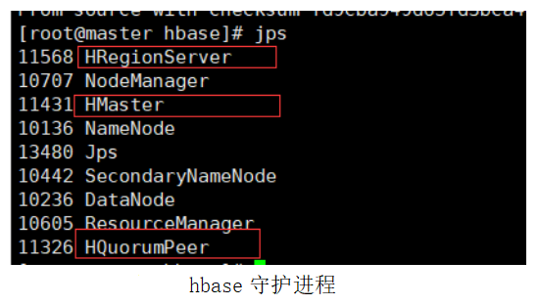
HBase installation and configuration
1. In the figure, HregionServer and Hmaster are the daemons of habse, and HquorumPeer is the daemon of zookeeper. When the three processes are running at the same time, it means that Hbase is working properly. Enter the command: jps

Slide 10
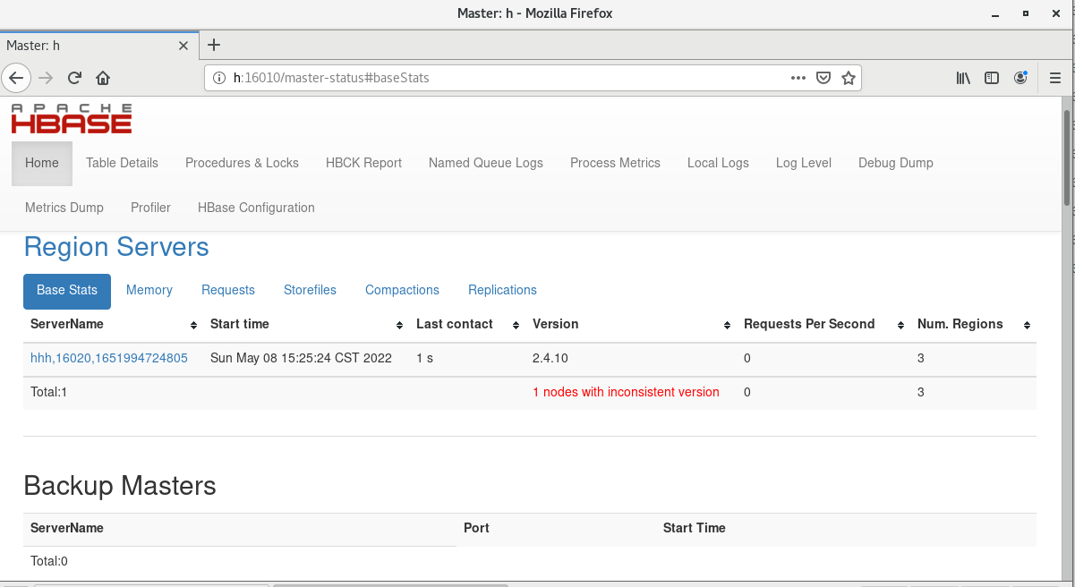
HBase installation and configuration
2. Check whether the startup is successful
Hbase provides a Web UI test interface at http://master:16010/master-status , which is used to view the running status of Hbase . Enter h(hadoop01):16010 in Firefox to view the running information of Hbase .
http://h:16010 in the firefox browser of the centOS7 virtual machine of the teacher's computer . The result is as follows:

Slide 11
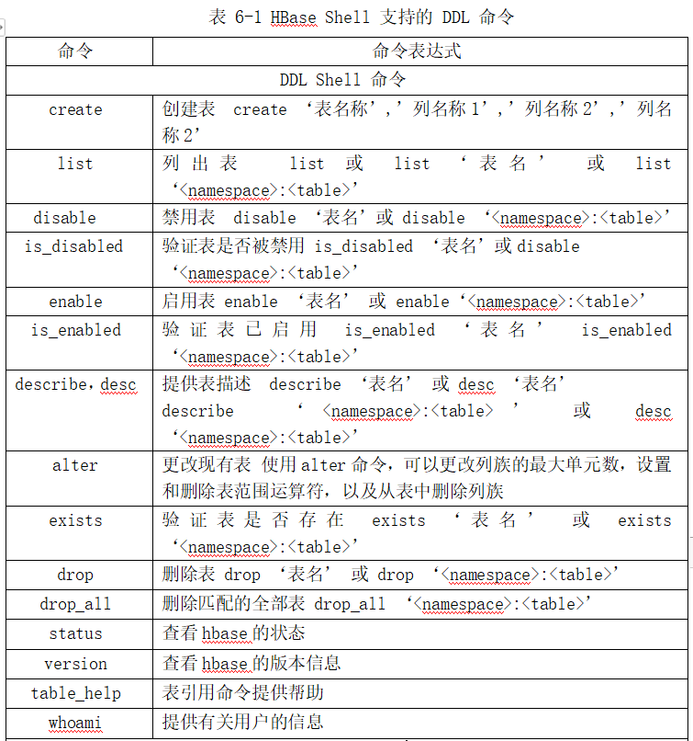
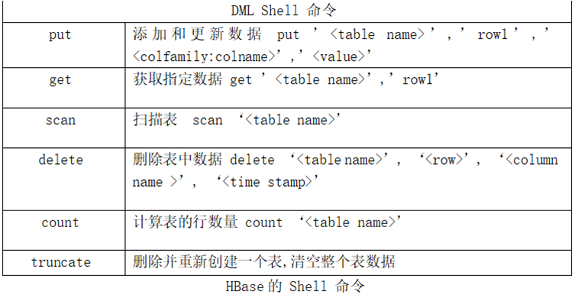
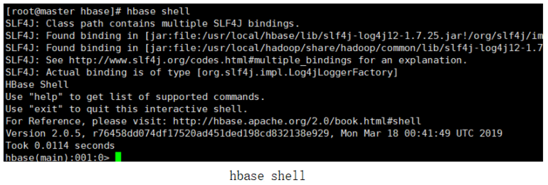
HBase Operation Data
Enter the HBase Shell workbench by entering hbase shell.

Slide 12
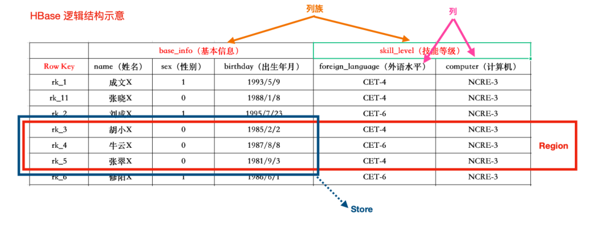
Notes:
RPC is the abbreviation of Remote Procedure
An HRegion consists of one or more Stores .
A Store consists of MemStore ( 1 ) and StoreFile (0 to more) ;
A Store stores a Columns Family ;
StoreFile is stored on HDFS ;
MemStore is stored in

Slide 13
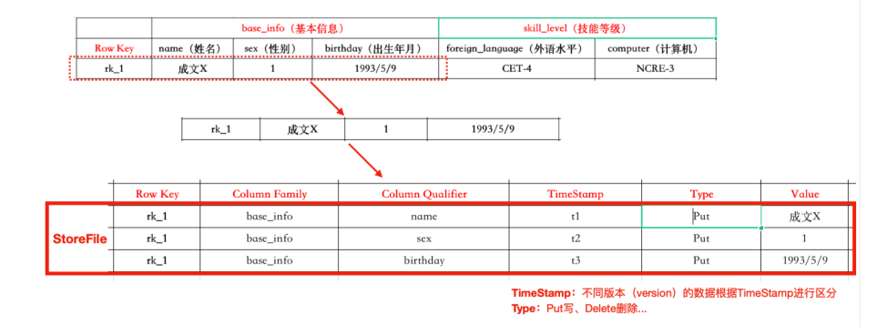
6.2 Solution Design
6.2.2 Hbase Architecture​​​​
Notes:
RPC is the abbreviation of Remote Procedure
An HRegion consists of one or more Stores .
A Store consists of MemStore ( 1 ) and StoreFile (0 to more) ;
A Store stores a Columns Family ;
StoreFile is stored on HDFS ;
MemStore is stored in

Slide 14
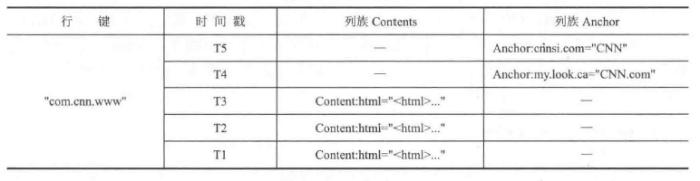
Assume that the following table is named webtable The table contains two column families : Contents and Anchor . In this example
Anchor There are two columns ( Anchor:cnnsi.com , Anchor : my.look.ca ),
Contents has only one column ( Content:html ) .
Notes:
6.2.2 Data model and related concepts
HBase is actually a sparse, multi-dimensional and persistent storage mapping table. It uses row key ( Crow key) , column
column name , column family, and timestamp . Each value is
Uninterpreted byte array Byte[]. The relevant concepts of HBase data model are introduced as follows.
(1) Table
Table is the basic management unit of HBase . Table is sorted by row . The schema of a table only defines its column families.
A column family can have any number of columns; each column can contain any number of versions; columns that have not had data inserted are empty;
Columns in a family are sorted and stored together.
(2) Row key
Each row has a row key to identify the row, which is the primary key for retrieving records.
(3) Column name
a concatenation of its column family prefix and a qualifier . For example, the column Contents:html
composed of the column family Contents, followed by a colon (:) and the modifier html .
(4) Column Family
A column family is a collection of columns in a table. These columns are not actual columns but are represented by modifiers.
Virtual columns. All column members of a column family have the same prefix. For example, the columns Courses:history and Courses:math
the Courses column family . The colon (:) is the column family separator, used to distinguish the prefix from the column name.
The column family must be declared when the table is created.
It is no longer needed and can be created at any time. Physically, members of a column family are stored together in the file system.
Because storage optimization is done at the column family level, this means that all members of a column family are stored in the same way.
Visited.
(5) Timestamp
Timestamp is used to indicate the version of the row key and column value corresponding to the column family. It is a 64 -bit integer and is usually expressed in system time (accurate to
milliseconds).
in 3ase is represented by byte arrays (Byte[]) (except for the table name), because the row key, column name, and timestamp are all
Converted to byte array for storage. HBase tables are sorted by row key, and all tables must have row keys.
The table does not require that all rows in the column family have data, nor is it necessary. If the row queried by the user does not have a specified column family, the returned
Returns empty.
HBase is a sparse, long-term storage (stored on disk), multi-dimensional and sorted mapping table.
The index of the table is the row key, column key and timestamp. The data in HBase are all strings.
Each row has a sortable primary key and any number of columns.
A row of data can have completely different columns. The format of the column name is "<family>:<qualifier>", which is composed of strings.
Each table has a set of column families, which is fixed and can only be changed by changing the table structure.
The qualifier value can be changed for each row. HBase stores data in the same column family in the same
The HBase write operation is row-locked, and each row is an atomic element that can be locked.
All database updates are marked with a timestamp. Each update is a new version. HBase will retain a certain
The number of versions, this value can be set, the client can choose to obtain the version unit closest to a certain point in time
value, or get the values of all version units at once.

Slide 15
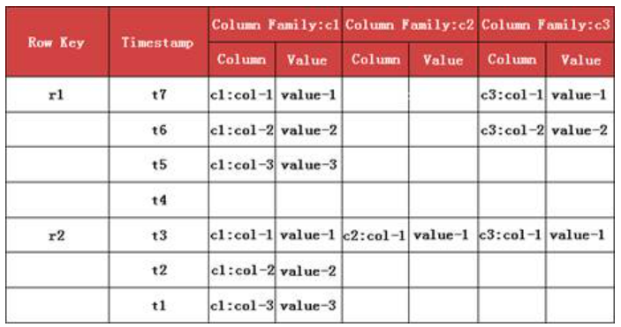
HBase Data Model
Data Model Overview
Notes:
https://www.itheima.com/news/20210518/175720.html
c1 , c2 , c3 are column family names

Slide 16
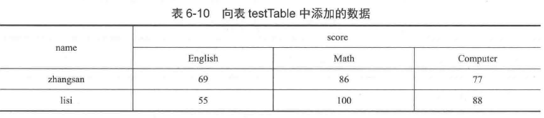
HBase Data Model
Data Model Overview
Table testtable ,
1. How many column clusters are included : What are the names of the column clusters ?
2. How many columns does each column cluster have and what are their names?
3. How many rows are there and what are the row keywords?
4. What type is the numerical value 100 here ?
Notes:
表testtable ，
1、包含几个列簇：列簇的名字各是什么，
2、每个列簇有几个列，列名各是什么？
3、有几行，行关键字是什么？
4、这里的100是什么类型？

Slide 17
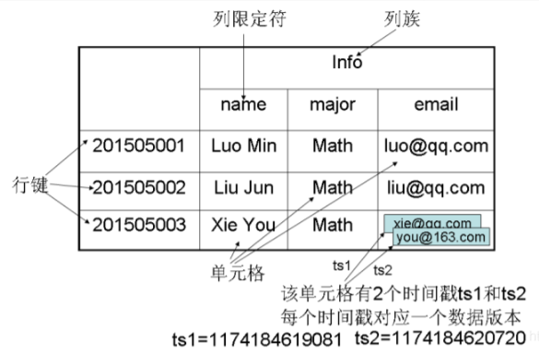

Slide 18
Hbase storage mechanism
Example: Employee Income Table
StaffIncome Table
Row key value (Row Key) ( Employee ID) | Timestamp​ | income column family
 |  | salary | bonus | Interest | stock​
A | T7 | 30000 |  |  | 12000
 | T3 | 25000 | 3000 | 1000 | 10000
 | T1 | 20000 | 2000
B | T6 | 10000
 | T2 | 6000 | 3000
C | T5 | 8000 | 1000 | 2000
Notes:
The following are the interpretations of the above data table:
A data table is similar to a two-dimensional sparse matrix. In fact, a data table in HBase is essentially a sparse matrix.
Data updates in a data table can update all columns in the row at once, or only update one or several columns in the row. In addition, data tables can flexibly expand data columns in column clusters without definition.
The data table is defined with employee ID as the row key value. Specific records can be located by searching for employee ID . By default, the record with the latest timestamp will be returned. For example, when querying all income of employee A , the returned value is <salary:30000 , bonus:3000 , interest:1000 , stock:12000> , the returned value of all income of employee B is <salary:10000 , bonus:3000> , and the returned value of all income of employee C is <salary:10000 , bonus:1000 , interest:2000> .
The timestamp allows you to intuitively see the historical version information of a row or column. By setting the version number range, you can query the previous data. This mechanism itself can alleviate data security issues caused by erroneous data update operations.

Slide 19
HBase Operation Data
Basic Operation
1. Enter the hbase database
hbase shell
2. View all namespaces
Namespace is similar to the database in a traditional database. It is mainly used to classify and manage different tables. Hbase has two pre-defined namespaces by default: default and hbase.
list_namespace
3. Create a new namespace
create_namespace ' name of the namespace '
4. Delete the namespace (need to delete the table first, to delete the table, you need to disable the table first)
drop_namespace ' myschool '
5. List all tables under the specified namespace
list_namespace_tables ' Name of the namespace '

Slide 20
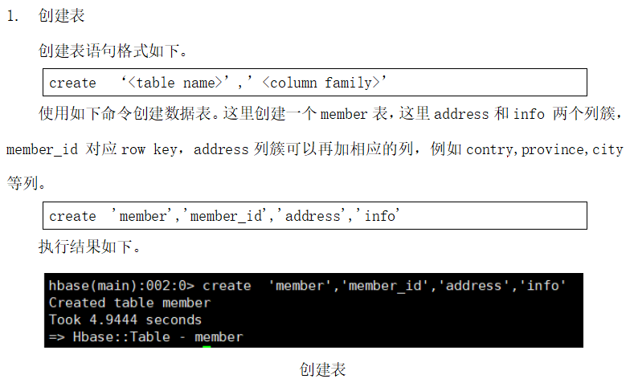
HBase Operation Data
Create the table:
create ' namespace : table name ', ' column family name 1', ' column family name 2',... (create the table in the specified namespace)
( Example: create a table named stuinfo in the namespace myshool , with a column family of info1)
create 'myschool:stuinfo','info1'
(Note: When namespace is not specified , it is created in default by default )

Slide 21
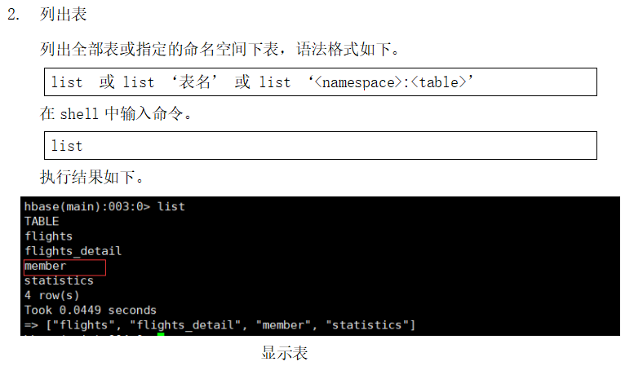
Hbase operation data

Slide 22
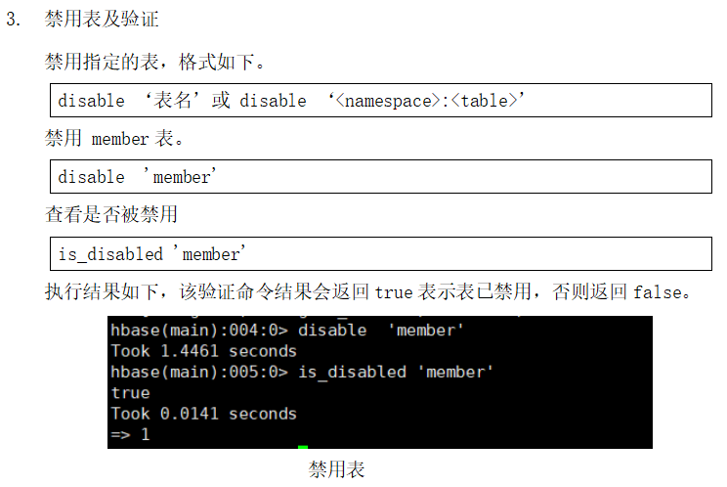
Hbase operation data

Slide 23
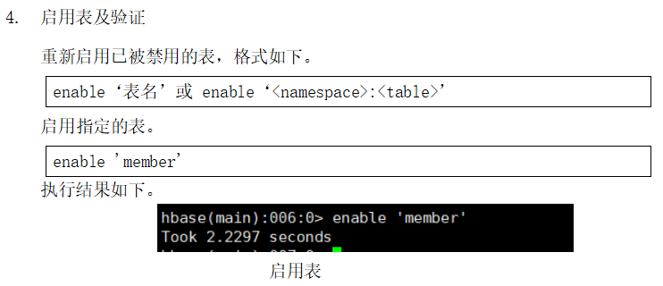
Hbase operation data

Slide 24
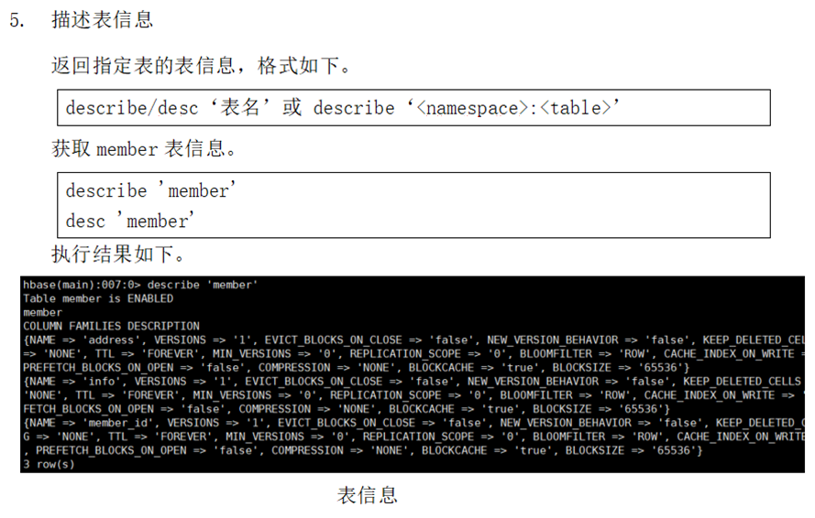
Hbase operation data

Slide 25
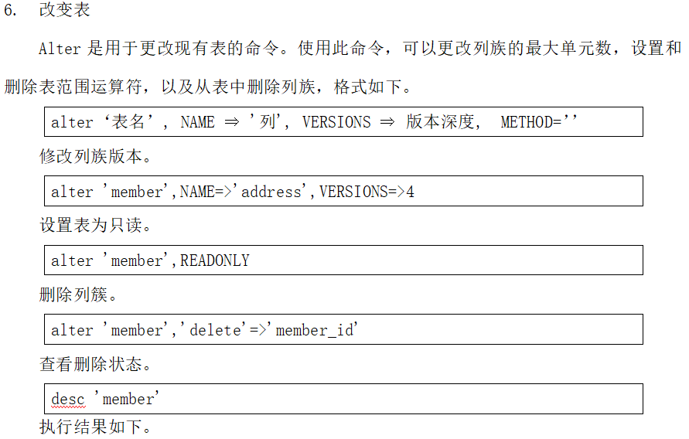
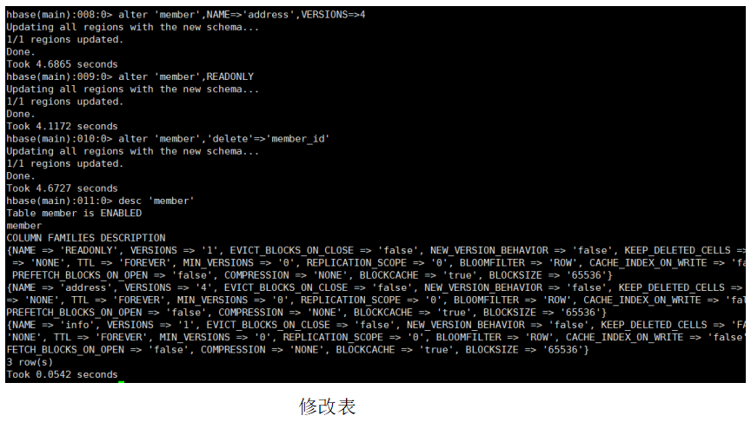
Hbase operation data

Slide 26
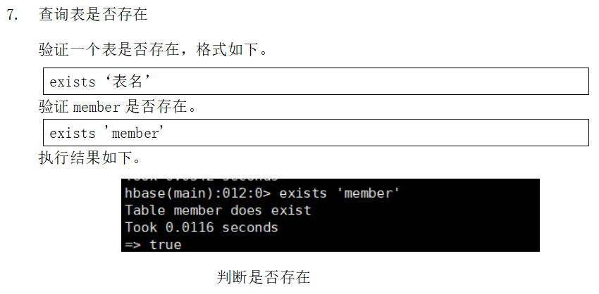
Hbase operation data

Slide 27
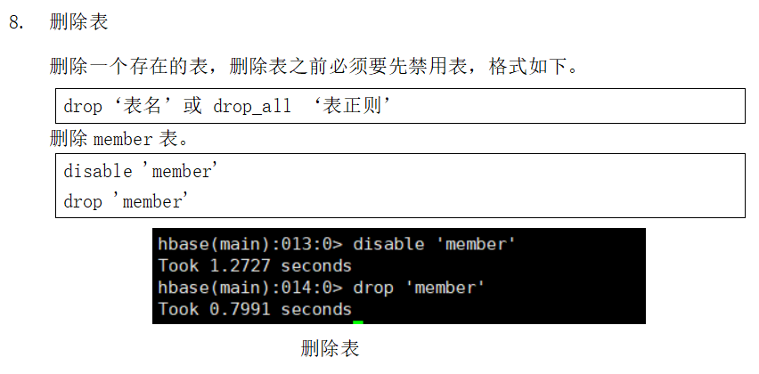
Hbase operation data

Slide 28
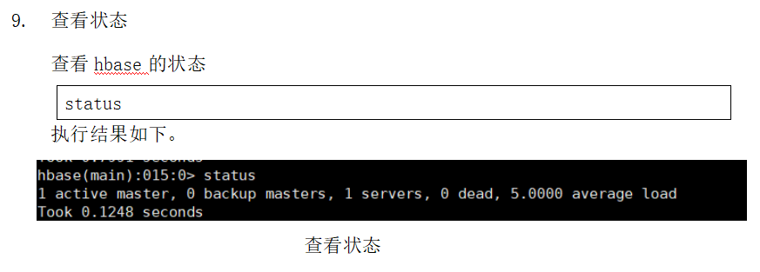
Hbase operation data

Slide 29
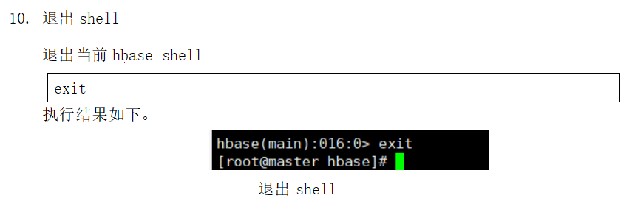
Hbase operation data

Slide 30
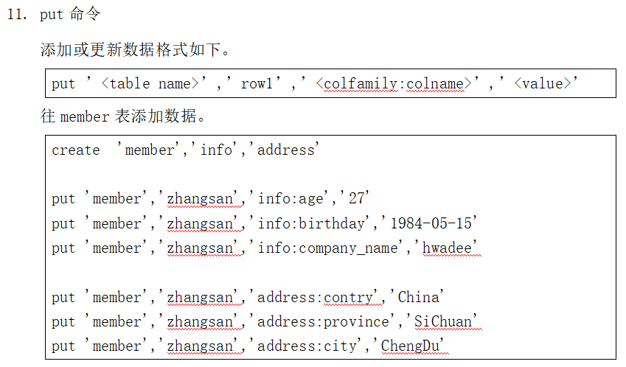
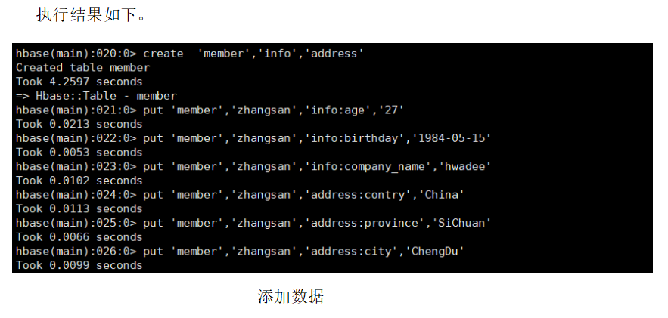
Hbase operation data

Slide 31
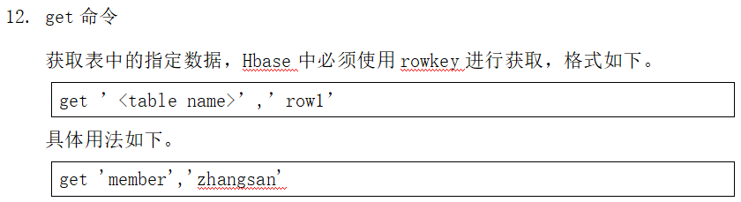
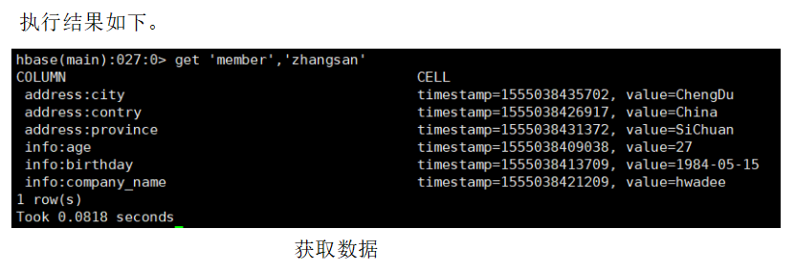
Hbase operation data

Slide 32
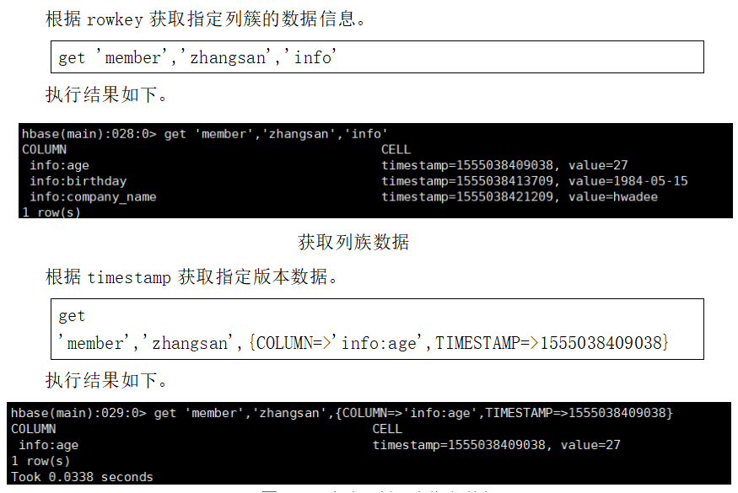
Hbase operation data

Slide 33
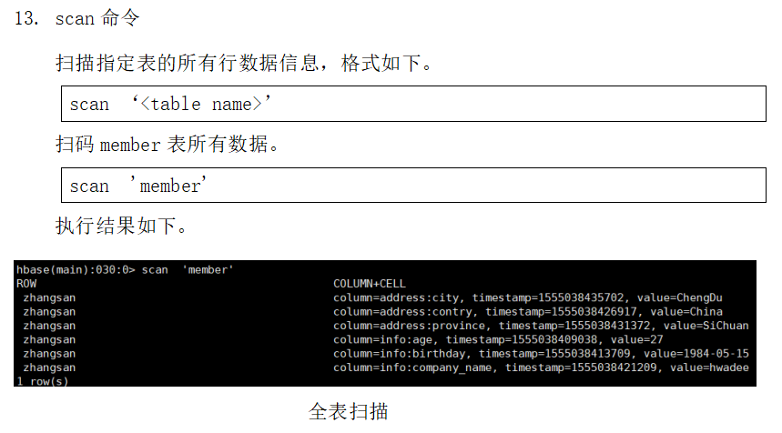
Hbase operation data

Slide 34
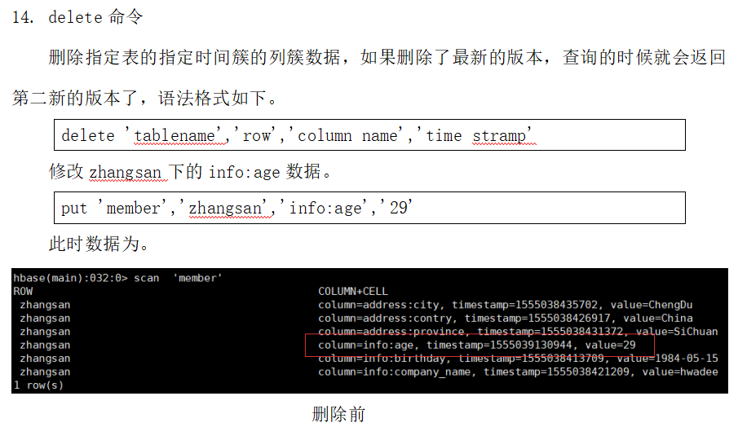
Hbase operation data

Slide 35
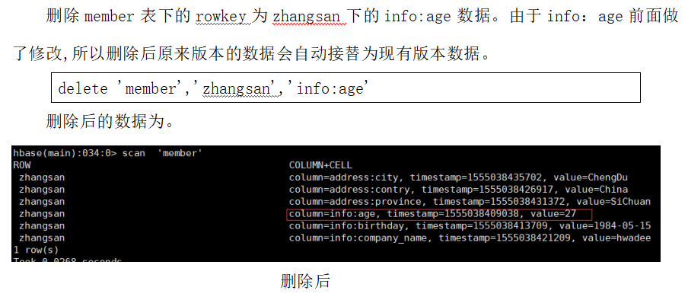
Hbase operation data

Slide 36
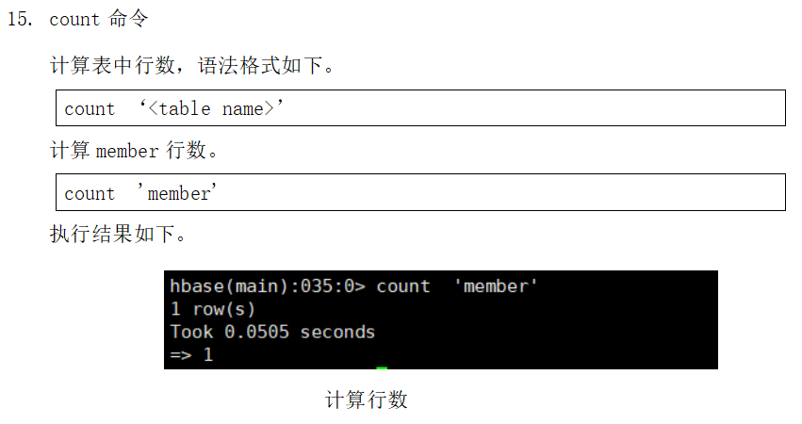
Hbase operation data

Slide 37
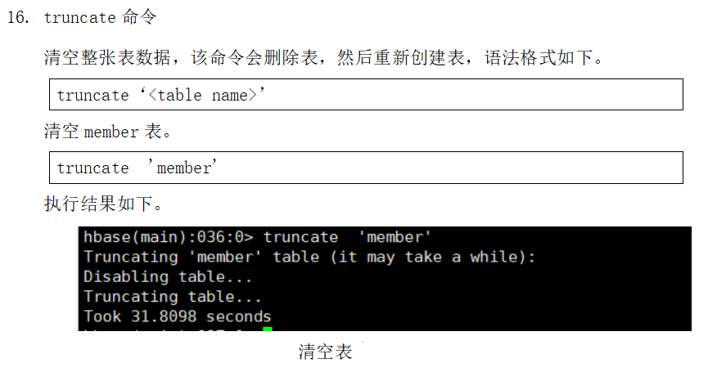
Hbase operation data

Slide 38
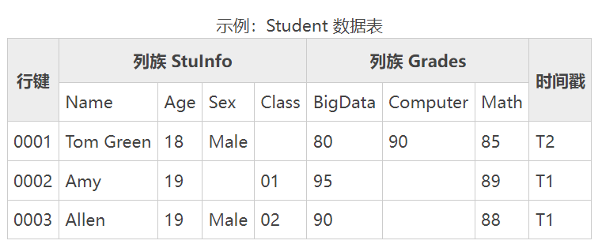
First create a namespace: ccc , then create a student table in ccc

Slide 39
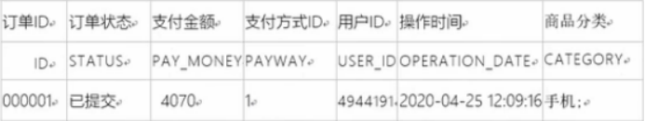
Hbase operation data
Example: Create a namespace test, and create a table orderinfo in the test namespace . Orderinfo has a column family c1 :
Notes:
create_namespace 'test'
create 'test:orderinfo','c1'
put 'test:orderinfo','000001','ID','000001'
put 'test:orderinfo','000001','STATUS','Submitted'
put 'test:orderinfo','000001','PAY_MONEY','4070'
put 'test:orderinfo','000001','PAYWAY','1'
put 'test:orderinfo','000001','USER_ID','4944191'
put 'test:orderinfo','000001','OPERATION_DATE','2020-04-25 12:09:16'
put 'test:orderinfo','000001','CATEGORY','Mobile'
1. Query 000001 row of data
Solution: Display Chinese characters (the default display in Hbase shell is hexadecimal encoding), add an attribute {FORMATTER=>'toString'} after the get command
get 'test:orderinfo' ,'00001'
2. Change the status of order ID 000001 to (paid). Note that a new timestamp will be generated after each put.
put 'test:orderinfo','00001','C1:STATUS','Paid'
3. Scan the order_info table (scan)
scan 'test:orderinfo'
4. Query order data (only 3 rows are displayed) (scan)
scan 'test:orderinfo' ,{limit =>3}
5. Check order status and payment method (scan)
scan 'test:orderinfo',{LIMIT=>1,COLUMNS=>['C1:STATUS','C1:PAYWAY']}
6. Delete the status column with order ID 000001
delect 'test:orderinfo','00001','C1:STATUS'
7. Delete all information with order ID 000001 (delete all columns)
delect 'test:orderinfo','00001','C1'

Slide 40
Hbase operation data
Example: Create a namespace test, an order table, and insert the following data into the table:
create_namespace 'test'
create 'test:orderinfo','c1'
put 'test:orderinfo','000001',c1 : STATUS','Submitted'
put 'test:orderinfo','000001',' c1 : PAY_MONEY','4070'
put 'test:orderinfo','000001',' c1 : PAYWAY','1'
put 'test:orderinfo','000001',' c1 : USER_ID','4944191'
put 'test:orderinfo','000001', ' c1 : OPERATION_DATE','2020-04-25 12:09:16'
put 'test:orderinfo','000001',' c1 : CATEGORY','mobile phone'
Notes:
create_namespace 'test'
create 'test:orderinfo','c1'
put 'test:orderinfo','000001','ID','000001'
put 'test:orderinfo','000001','STATUS','Submitted'
put 'test:orderinfo','000001','PAY_MONEY','4070'
put 'test:orderinfo','000001','PAYWAY','1'
put 'test:orderinfo','000001','USER_ID','4944191'
put 'test:orderinfo','000001','OPERATION_DATE','2020-04-25 12:09:16'
put 'test:orderinfo','000001','CATEGORY','Mobile'
1. Query 000001 row of data
Solution: Display Chinese characters (Hbase shell displays hexadecimal characters by default). Add an attribute {FORMATTER=>'toString'} after the get command.
get 'test:orderinfo' ,'00001'
2. Change the status of order ID 000001 to (paid). Note that a new timestamp will be generated after each put.
put 'test:orderinfo','00001','C1:STATUS','Paid'
3. Scan the order_info table (scan)
scan 'test:orderinfo'
4. Query order data (only 3 rows are displayed) (scan)
scan 'test:orderinfo' ,{limit =>3}
5. Check order status and payment method (scan)
scan 'test:orderinfo',{LIMIT=>1,COLUMNS=>['C1:STATUS','C1:PAYWAY']}
6. Delete the status column with order ID 000001
delect 'test:orderinfo','00001','C1:STATUS'
7. Delete all information with order ID 000001 (delete all columns)
delect 'test:orderinfo','00001','C1'

Slide 41
Hbase operation data
1. Query 000001 row of data
Solution: Display Chinese characters ( Hbase shell displays hexadecimal characters by default). Add an attribute {FORMATTER=>' toString '} after the get command.
get ' test:orderinfo ' ,'00001'
2. Change the status of the order ID 000001 to (paid). Note that a new timestamp will be generated after each
put 'test:orderinfo','00001','C1:STATUS',' Paid '
3. Scan the order_info table ( scan )
scan ' test:orderinfo '
4. Query order data (only 3 rows are displayed) ( scan )
scan ' test:orderinfo ' ,{LIMIT=>3}
5. Check order status and payment method ( scan )
scan ' test:orderinfo ',{LIMIT=>1,COLUMNS=>['C1:STATUS','C1:PAYWAY']}
6. Delete the status column
delect 'test:orderinfo','00001','C1:STATUS'
7. Delete all information with order ID 000001 (delete all columns)
delet eall 'test:orderinfo','00001','C1'
Notes:
create_namespace 'test'
create 'test:orderinfo','c1'
put 'test:orderinfo','000001','ID','000001'
put 'test:orderinfo','000001','STATUS','Submitted'
put 'test:orderinfo','000001','PAY_MONEY','4070'
put 'test:orderinfo','000001','PAYWAY','1'
put 'test:orderinfo','000001','USER_ID','4944191'
put 'test:orderinfo','000001','OPERATION_DATE','2020-04-25 12:09:16'
put 'test:orderinfo','000001','CATEGORY','Mobile'
1. Query 000001 row of data
Solution: Display Chinese characters (Hbase shell displays hexadecimal characters by default). Add an attribute {FORMATTER=>'toString'} after the get command.
get 'test:orderinfo' ,'00001'
2. Change the status of order ID 000001 to (paid). Note that a new timestamp will be generated after each put.
put 'test:orderinfo','00001','C1:STATUS','Paid'
3. Scan the order_info table (scan)
scan 'test:orderinfo'
4. Query order data (only 3 rows are displayed) (scan)
scan 'test:orderinfo' ,{limit =>3}
5. Check order status and payment method (scan)
scan 'test:orderinfo',{LIMIT=>1,COLUMNS=>['C1:STATUS','C1:PAYWAY']}
6. Delete the status column with order ID 000001
delect 'test:orderinfo','00001','C1:STATUS'
7. Delete all information with order ID 000001 (delete all columns)
delect 'test:orderinfo','00001','C1'

Slide 42
Hbase operation data
1. Query 000001 row of data
Solution: Display Chinese characters ( Hbase shell displays hexadecimal characters by default). Add an attribute {FORMATTER=>' toString '} after the get command.
get ' test:orderinfo ' ,'00001'
2. Change the status of the order ID 000001 to (paid). Note that a new timestamp will be generated after each
put 'test:orderinfo','00001','C1:STATUS',' Paid '
3. Scan the order_info table ( scan )
scan ' test:orderinfo '
4. Query order data (only 3 rows are displayed) ( scan )
scan ' test:orderinfo ' ,{LIMIT=>3}
5. Check order status and payment method ( scan )
scan ' test:orderinfo ',{LIMIT=>1,COLUMNS=>['C1:STATUS','C1:PAYWAY']}
6. Delete the status column
delete 'test:orderinfo','00001','C1:STATUS'
7. Delete all information with order ID 000001 (delete all columns)
delete eall 'test:orderinfo','00001','C1'
Notes:
create_namespace 'test'
create 'test:orderinfo','c1'
put 'test:orderinfo','000001','ID','000001'
put 'test:orderinfo','000001','STATUS','Submitted'
put 'test:orderinfo','000001','PAY_MONEY','4070'
put 'test:orderinfo','000001','PAYWAY','1'
put 'test:orderinfo','000001','USER_ID','4944191'
put 'test:orderinfo','000001','OPERATION_DATE','2020-04-25 12:09:16'
put 'test:orderinfo','000001','CATEGORY','Mobile'
1. Query 000001 row of data
Solution: Display Chinese characters (Hbase shell displays hexadecimal characters by default). Add an attribute {FORMATTER=>'toString'} after the get command.
get 'test:orderinfo' ,'00001'
2. Change the status of order ID 000001 to (paid). Note that a new timestamp will be generated after each put.
put 'test:orderinfo','00001','C1:STATUS','Paid'
3. Scan the order_info table (scan)
scan 'test:orderinfo'
4. Query order data (only 3 rows are displayed) (scan)
scan 'test:orderinfo' ,{limit =>3}
5. Check order status and payment method (scan)
scan 'test:orderinfo',{LIMIT=>1,COLUMNS=>['C1:STATUS','C1:PAYWAY']}
6. Delete the status column with order ID 000001
delect 'test:orderinfo','00001','C1:STATUS'
7. Delete all information with order ID 000001 (delete all columns)
delect 'test:orderinfo','00001','C1'

Slide 43
Hbase operation data
Classroom Exercise: Create the data table below
1. Namespace: pxx
2. Table name: ha
3. Create a data table structure and add the data in the following table
create_namespace ' pxx '
create ' pxx:ha ',' personal ','office'

Slide 44
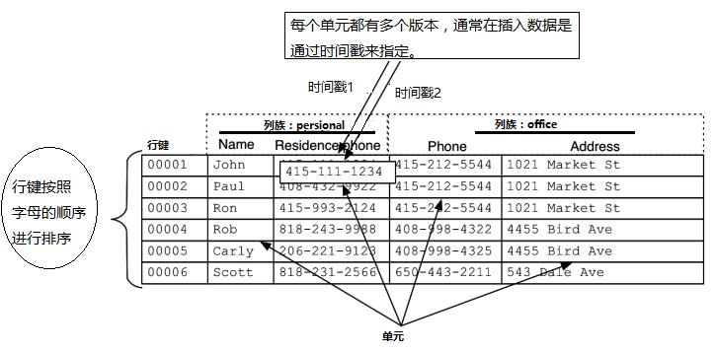
Namespace: pxx , Create a table ha in pxx , ha has two column families

Slide 45
Hbase operation data
1. Query 0000 5 rows of data
2. Query the value of the modifier Address of 0000 6 and change it to (Foshan - Guangdong Neusoft University)
3. Scan the hadoopxx -xxx table (scan)
4. Query the first three rows of data (only 3 rows are displayed) (scan)
5. Query the name and phone number in row
6. Delete
7. Delete all information with row key 00001 (delete all columns)
Notes:
1.get 'pxx:ha','00005'
2.put 'pxx:ha','00006','office:Address',' Foshan - Guangdong Neusoft University '
3.scan ' pxx:ha '
4.scan ' pxx:ha ',{LIMIT=>3}
5.get 'pxx:ha','00002','persional:name','office:Phone'
6.delete 'pxx:ha','00001','office:Address'
7. deleteall 'pxx:ha','00001'

Slide 46
Hbase operation data
Classroom Exercise: Create the data table below
1. Namespace: practice-xx (01 , 02 , 03)
2. Create a table name under practice-xx : stuInfoGrade
The data table structure is as shown below and add the data in the following table

Slide 47
Hbase operation data
stuInfoGrade Data Sheet
Row Key | Column family name: StuInfo |  |  |  | Column Family Name: Grades |  |  | Timestamp
 | Name | Age | Sex | Class | BigData | Computer | Math
1 | Tom Green | 18 | Male |  | 80 | 90 | 85 | T2
2 | Amy | 19 |  | 1 | 95 |  | 89 | T1
3 | Allen | 19 | Male | 2 | 90 |  | 88 | T1

Slide 48
Hbase operation data
1. Query the third row of data
2. Query the value of the modifier sex in 2 and change it to female
3. Describe stuInfoGrade Table structure ( describe )
4. Query the first three rows of data (only 3 rows are displayed) (scan)
5. Query 2 rows of name and bigdata
6. Delete
7. List all tables

